Slide 1
Disaster Preparations and Relief
Myth-busting
Disasters like tornados, severe flooding, wildfires,
explosions, terror attacks never happen here in Ontario and
the government will take care of us.
Disasters are too big for us to handle. We don’t have any
kind of expertise, infrastructure or means to handle
disasters.
Our members are too old to help in a disaster.
We should leave disaster relief to groups like the Red Cross, they have enough help.

Slide 2





Christian Response to Disaster

Slide 3
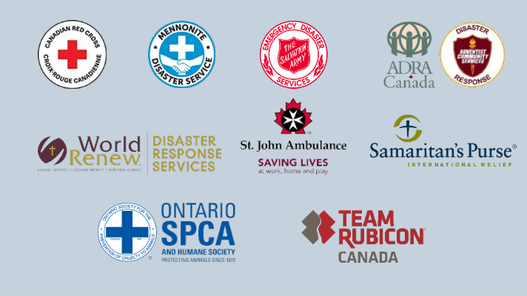
NGO Alliance

Slide 4
Catholic Response to Disaster ?
Knights of Columbus
Disaster Services

Slide 5
Help From Supreme
To help us address the Spring 2019 Flooding Disaster in Ontario Supreme has provided us with some much needed resources:
  $30,000 up front money to spend on disaster relief
  200 X $100 USD Visa Pre-paid Cards for flood survivors
  200 Knights of Columbus Disaster Relief Safety Vests for volunteers
  A pallet load of Personal Protective Equipment – Tyvek coveralls, gloves, etc…
  Recognition and publicity for our relief efforts – Columbia Magazine and the Supreme Website

Slide 6
The K of C and the NGO Alliance?
We are now connected in our disaster response with the other Non-Government Organizations (NGO) via the NGO Alliance.
We have coordinated our efforts to avoid duplication of effort and resources and taking care not to get in each other’s way or cause any confusion.
--------
Knights of Columbus
Disaster Services

Slide 7

How About St. Vincent de Paul ?
We are now connected across Canada in our disaster response with St. Vincent de Paul.
K of C referrals of disaster survivors to SVdP
SVdP House-in-a-Box program (coming soon to Canada)
--------

Slide 8
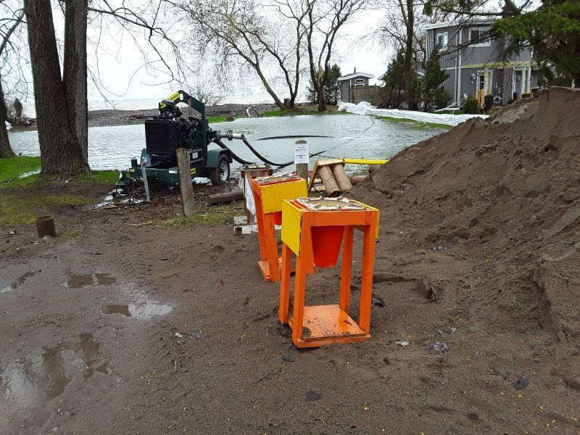
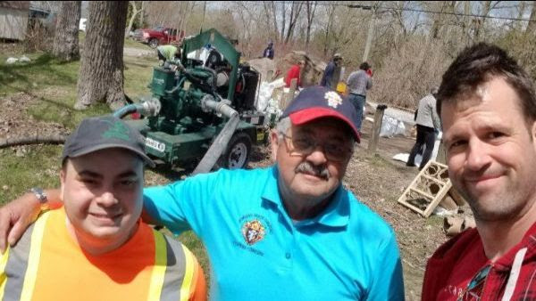
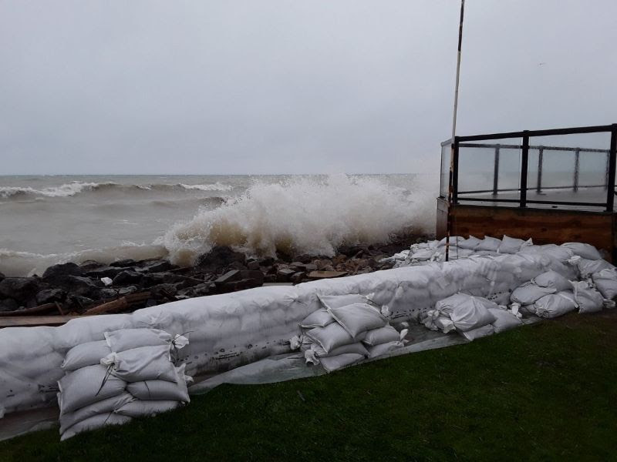
Clarington
Approximately 1300 sandbags were filled in the first 4 hours, saving several homes along the shoreline of lake Ontario. (May 14, 2019)

Slide 9
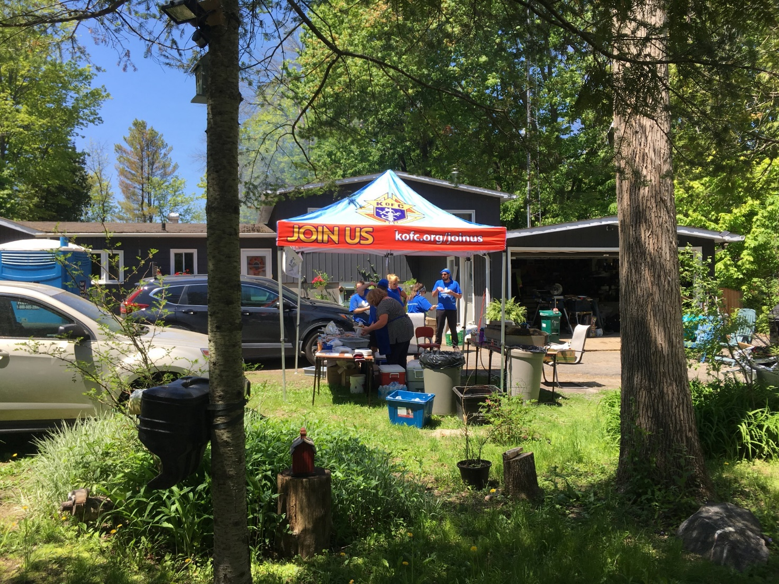
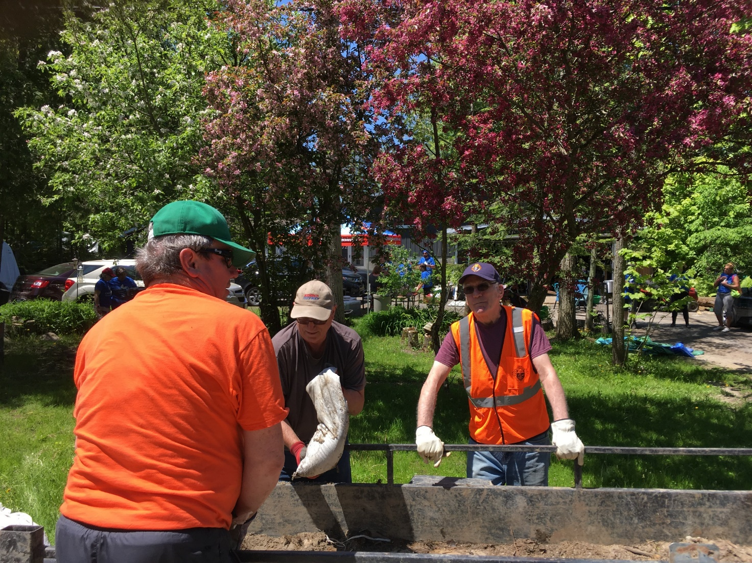
Fitzroy Harbor (West Ottawa)
15 Knights of Columbus Volunteers worked the first two weekends in June removing sandbags and feeding lunch to volunteers and returning residents and the Knights paid for the fork lift rental.

Slide 10
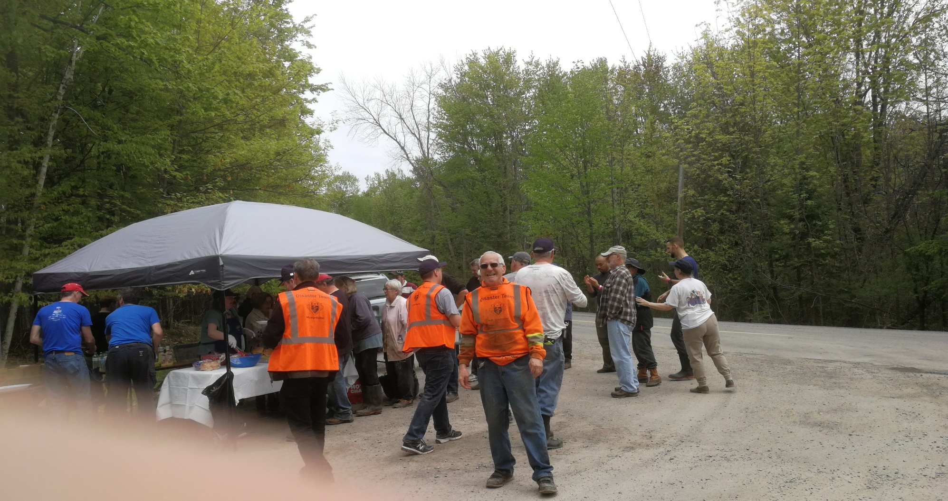
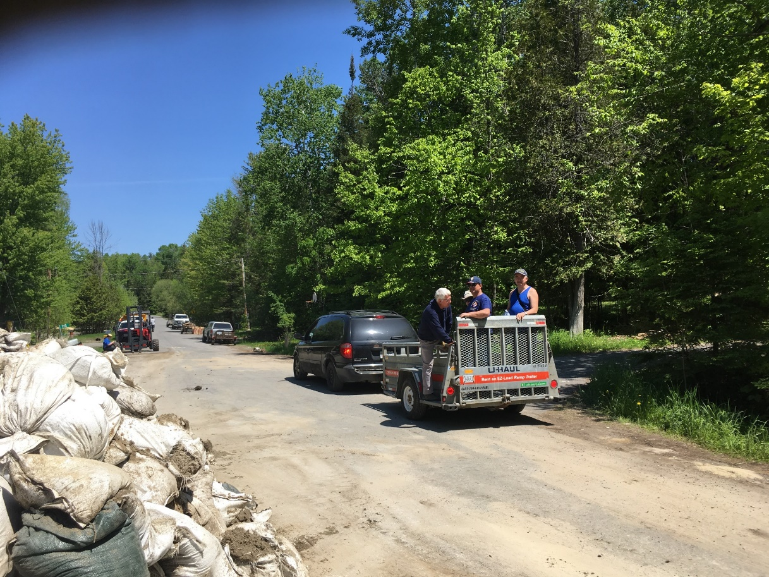
Fitzroy Harbor (West Ottawa)

Slide 11
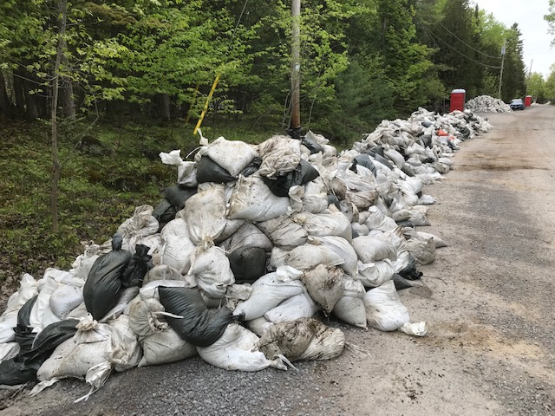
Fitzroy Harbor (West Ottawa)

Slide 12
Whitewater Region
Whitewater Region - 650 properties on the 62 km of shoreline
320,00 Sandbags and 200 Dump Trucks of Sands (10-12 Yards/load) that were placed to help protect the properties and most of the soggy and contaminated sandbags had to be removed when the waters receded.
175 homes and 160 seasonal cottages were affected.
Over 100 hundred homes had to be evacuated.

Slide 13
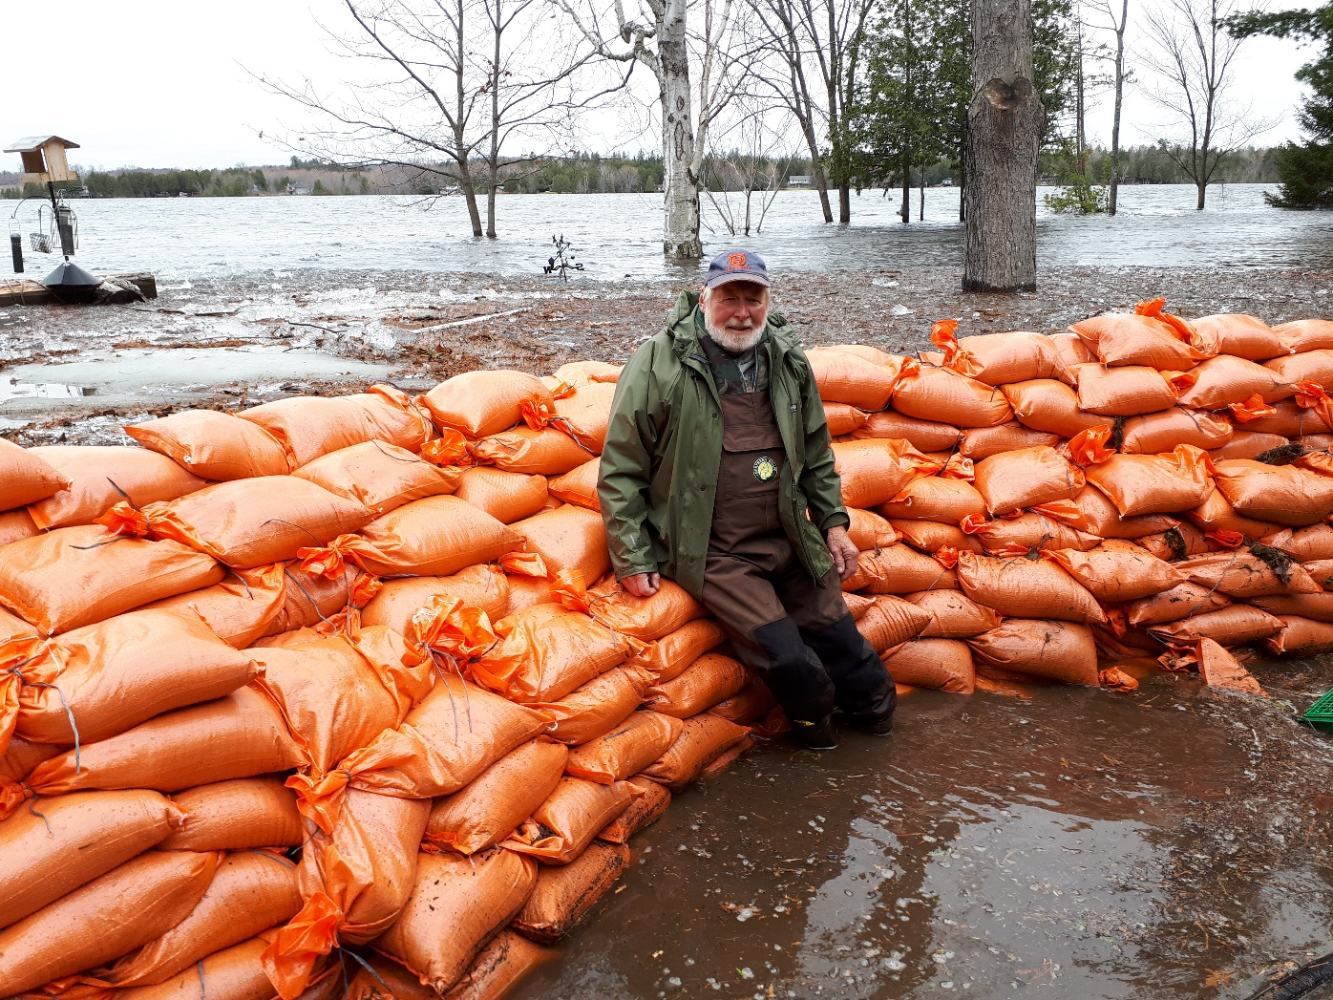
Westmeath (Whitewater Region)
Brother Knight Vince Gervais
Manning the pumps in the icy waters of April 27, 2019. Vince and his wife Margarit would work at flood response and coordinating relief efforts in their community, volunteering 40-60 hours per week, sometimes on a 24/7 basis for days at a time and totaling over 800 hours of volunteer work.

Slide 14
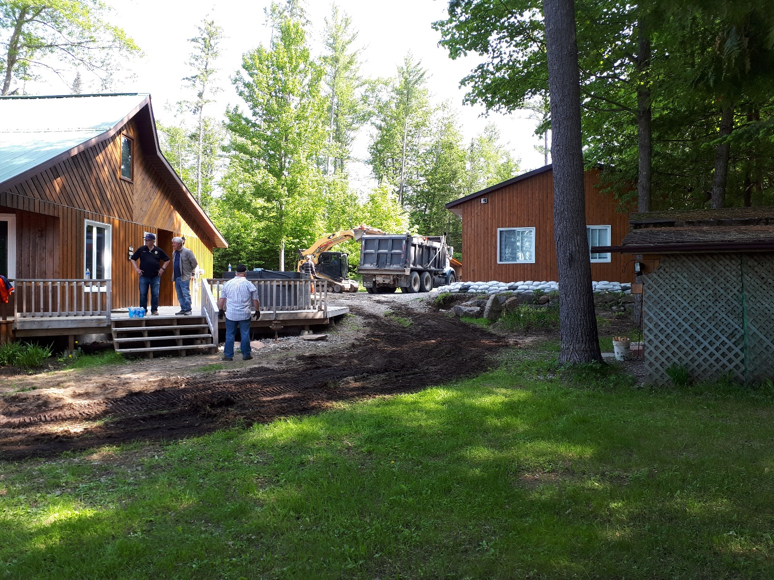
Westmeath (Whitewater Region)
About 6 weeks later Vince helped coordinate sandbag removal from dozens of homes and cottages in the Whitewater Region. In one day alone Vince coordinated the removal of over 60,000 sandbags in just two locations along the 62 km of shoreline.
Vince visits local residents every day and on behalf of the K of C he helped distribute 80 of our K of C pre-paid $100 Visa cards to the neediest families in the Whitewater Region.

Slide 15
District Deputies
  Take on a leadership role in disaster reponse
  Tell your council about our disaster response to the
  spring floods
  Discuss things the councils in your District can do
  to be prepared for a disaster:
          Appoint a disaster relief chariman in every council.
  Help set up and maintin disaster communication phone trees – province-wide, district and council.

Slide 16
District Deputies
Stay tuned.....we are only beginning our Disaster preparedness and Relief program
More exciting things to follow......

